Slide 1

Subtractor; Multiplexer
Computer Organization and Architecture | Introduction to Digital Fundamentals
Course: Computer Organization and Architecture | Chapter: Introduction to Digital Fundamentals | Program: Bachelor of Engineering
DISCOVER · LEARN · EMPOWER
Notes:
Welcome to today's lecture on Subtractor and Multiplexer circuits. These are fundamental building blocks in digital logic design. We will explore how they function and why they are critical for arithmetic operations. Remember, mastering these concepts is key to designing complex digital systems.

Slide 2
Course Outcomes
SLIDE 2 / 14
Course Outcome
CO | BT LEVEL | DESCRIPTION
CO1 | BT3 | Apply number systems and digital logic to design basic digital circuits
CO2 | BT4 | Analyze register organization and instruction set architecture
CO3 | BT3 | Implement computer arithmetic algorithms and floating-point operations
CO4 | BT5 | Analyze memory hierarchy and input-output organization
CO5 | BT6 | Evaluate control unit design and pipelining performance
Chandigarh University
2 / 14
Notes:
Today's lecture directly addresses Course Outcome 1. You will learn to apply digital logic principles to design subtractors and multiplexers. These circuits are essential for implementing arithmetic functions in hardware. By the end, you will understand how to construct these basic digital circuits effectively.

Slide 3
Learning Objectives
SLIDE 3 / 14
Learning Outcomes
1
Analyze the working principle of half and full subtractors
2
Construct truth tables for subtraction operations with borrow bits
3
Evaluate the role of multiplexers in data selection logic
4
Design a 4-to-1 multiplexer using basic logic gates
5
Compare the efficiency of subtractors versus adder-subtractor units
Chandigarh University
3 / 14
Notes:
By the end of this session, you will be able to analyze how subtractors handle binary subtraction. You will construct truth tables to verify borrow generation. We will also evaluate how multiplexers select data based on control lines. Finally, you will design a multiplexer circuit and compare it with adder-subtractor units.

Slide 4
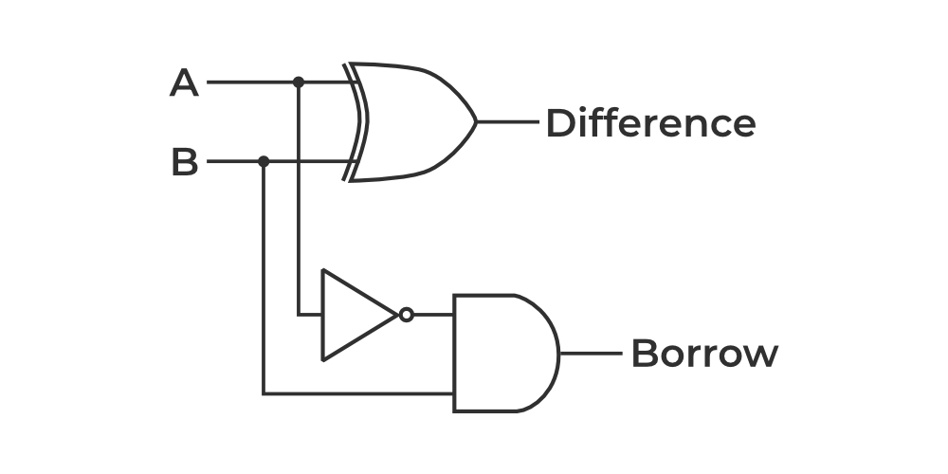
Lecture
SLIDE 4 / 14
Half Subtractor Fundamentals
IT PRODUCES TWO OUTPUTS
Difference and Borrow
• A half subtractor subtracts two single-bit binary numbers
• Difference is the XOR of inputs A and B
• Borrow is the AND of A and NOT B
• It cannot handle a borrow input from a previous stage
• Used only for the least significant bit in multi-bit subtraction
• Truth table shows four possible input combinations for A and B
Half Subtractor in Digital Logic - GeeksforGeeks
Chandigarh University
4 / 14
Notes:
A half subtractor is the simplest subtraction circuit. It takes two inputs, A and B, and produces a Difference and a Borrow. For example, if A is 1 and B is 0, the difference is 1 and borrow is 0. However, it cannot handle a borrow coming from a lower bit, limiting its use to the least significant position.

Slide 5
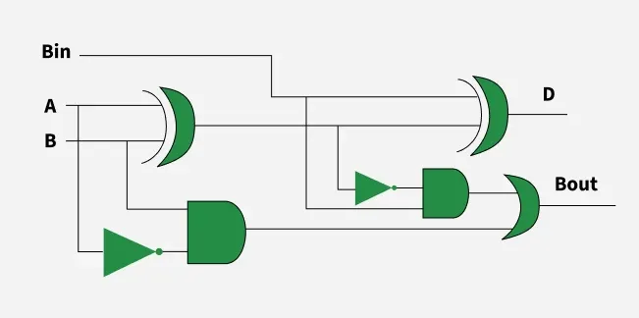
Lecture
SLIDE 5 / 14
Full Subtractor Logic
1
A full subtractor handles three inputs: A, B, and Borrow-in
2
It produces a Difference and a Borrow-out
3
Difference is the XOR of A, B, and Borrow-in
4
Borrow-out is generated if A is less than B plus Borrow-in
5
Two half subtractors and an OR gate form a full subtractor
6
Essential for multi-bit binary subtraction operations
7
Truth table includes eight rows for all input combinations
Full Subtractor in Digital Logic - GeeksforGeeks (source: media.geeksforgeeks.org)
Chandigarh University
5 / 14
Notes:
A full subtractor extends the half subtractor by including a borrow-in input. This allows it to handle cascaded subtraction. For instance, subtracting 1 from 0 with a borrow-in of 1 results in a difference of 0 and a borrow-out of 1. This circuit is crucial for building multi-bit subtractors.

Slide 6
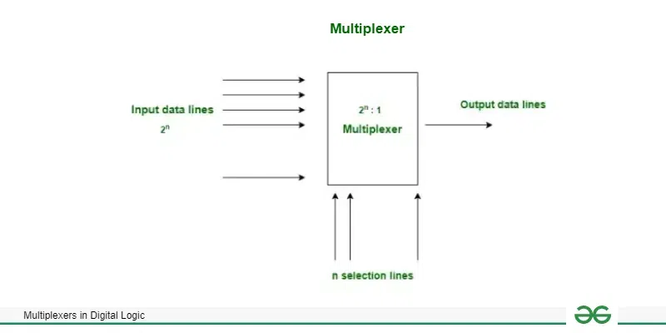
Worked Example
SLIDE 6 / 14
4-bit Subtraction
1
Subtract binary 0101 (5) from 1010 (10) using full subtractors
2
Bit 0: 0 minus 1 requires a borrow, resulting in 1
3
Bit 1: 1 minus 0 minus borrow-in results in 0
4
Bit 2: 0 minus 1 requires a borrow, resulting in 1
5
Bit 3: 1 minus 0 minus borrow-in results in 0
6
Final result is 0101 (5), confirming 10 minus 5 equals 5
7
Borrow-out from the most significant bit indicates negative result
Multiplexers - GeeksforGeeks (source: media.geeksforgeeks.org)
Chandigarh University
6 / 14
Notes:
Let's work through subtracting 5 from 10 in binary. We start from the least significant bit. 0 minus 1 requires a borrow, giving a difference of 1. Moving left, we handle borrows carefully. The final result is 0101, which is 5 in decimal. This demonstrates how full subtractors chain together to perform multi-bit arithmetic.

Slide 7
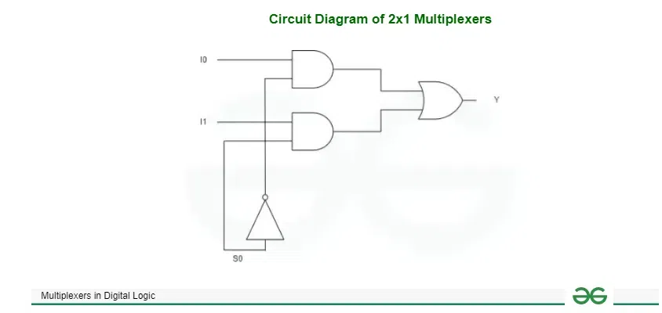
Lecture
SLIDE 7 / 14
Common Pitfalls in Subtraction
1
Forgetting to propagate borrow to the next higher bit
2
Confusing borrow-in with borrow-out in cascaded stages
3
Incorrectly implementing the XOR logic for difference calculation
4
Assuming a half subtractor works for all bit positions
5
Misinterpreting the final borrow-out as a sign bit without context
6
Neglecting to handle the case where the result is negative
7
Overlooking the need for a full subtractor in multi-bit designs
Multiplexers - GeeksforGeeks (source: media.geeksforgeeks.org)
Chandigarh University
7 / 14
Notes:
Students often forget to propagate borrows correctly, leading to wrong results. Another common error is confusing borrow-in and borrow-out signals. Always verify your XOR logic for the difference bit. Remember, a half subtractor is insufficient for anything other than the least significant bit.

Slide 8
Lecture
SLIDE 8 / 14
Multiplexer Basics
1
A multiplexer selects one input from many based on control lines
2
It acts as a digital switch routing data to a single output
3
An n-to-1 multiplexer requires n inputs and log2(n) select lines
4
The output equals the value of the selected input line
5
Common types include 2-to-1, 4-to-1, and 8-to-1 multiplexers
6
Used extensively in data routing and function implementation
7
Symbol shows multiple inputs, select lines, and a single output
Multiplexers - GeeksforGeeks (source: media.geeksforgeeks.org)
Chandigarh University
8 / 14
Notes:
A multiplexer is essentially a digital switch that selects one input to pass to the output. For a 4-to-1 multiplexer, you need two select lines to choose among four inputs. If select lines are 00, input 0 goes to the output. This component is vital for data routing in complex systems.

Slide 9
Lecture
SLIDE 9 / 14
Multiplexer Implementation Logic
GOVERNING EQUATION
For 4-to-1: Y = (S1'S0'I0) + (S1'S0'I1) + (S1S0'I2) + (S1S0'I3)
1
Output is the sum of minterms corresponding to select line values
2
Each input is ANDed with a unique combination of select lines
3
All AND outputs are combined using a single OR gate
4
S1 and S0 are the select lines, I0 to I3 are data inputs
5
Logic ensures only one input path is active at any time
6
Can be implemented using basic AND, OR, and NOT gates
Full Subtractor in Digital Logic - GeeksforGeeks (source: media.geeksforgeeks.org)
Chandigarh University
9 / 14
Notes:
The internal logic of a multiplexer uses AND gates to decode select lines. Each AND gate corresponds to a specific input. For example, if select lines are 10, the third AND gate activates. The OR gate combines these paths. This ensures only the selected input reaches the output.

Slide 10
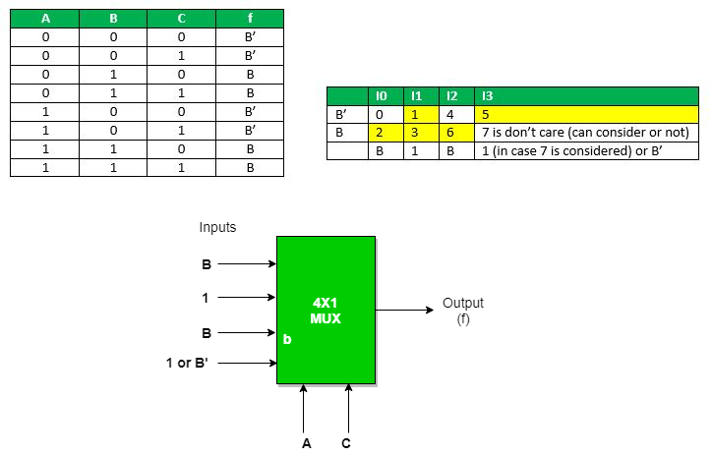
Worked Example
SLIDE 10 / 14
4-to-1 MUX
GOVERNING EQUATION
Inputs: I0=1, I1=0, I2=1, I3=0
SELECT LINES
S1=1, S0=0
• Binary 10 corresponds to input I2
• I2 value is 1, so Output Y = 1
• If S1=0, S0=1, Output Y = I1 = 0
• Demonstrates how select lines route specific data
• Truth table confirms output matches selected input
Source: media.geeksforgeeks.org
Chandigarh University
10 / 14
Notes:
Let's test a 4-to-1 multiplexer. If inputs are 1, 0, 1, 0 and select lines are 10, we select input I2. Since I2 is 1, the output is 1. If we change select lines to 01, we select I1, which is 0. This shows how the MUX dynamically routes data based on control signals.

Slide 11
Lecture
SLIDE 11 / 14
Applications of Multiplexers
1
Data routing in communication systems and buses
2
Implementing Boolean functions using fewer logic gates
3
Parallel-to-serial data conversion in transmission systems
4
Memory address selection in computer architectures
5
Signal selection in audio and video processing units
6
Reducing hardware complexity in digital circuit design
7
Used in ALUs for selecting arithmetic or logic results
Multiplexers - GeeksforGeeks (source: media.geeksforgeeks.org)
Chandigarh University
11 / 14
Notes:
Multiplexers are ubiquitous in digital systems. They route data in buses and select memory addresses. In ALUs, they choose between addition or subtraction results. They also convert parallel data to serial for transmission. Their ability to implement logic functions reduces the need for complex gate networks.

Slide 12
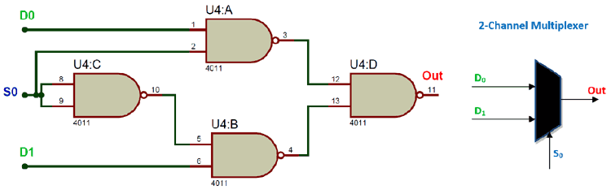
Lecture
SLIDE 12 / 14
Pitfalls in Multiplexer Design
1
Incorrectly mapping select lines to input indices
2
Forgetting to tie unused inputs to ground or Vcc
3
Assuming all inputs are active simultaneously
4
Overlooking propagation delay in high-speed designs
5
Using too many multiplexers instead of a single complex one
6
Neglecting to handle don't-care conditions in logic simplification
7
Misinterpreting the output when select lines are invalid
Source: circuitdigest.com
Chandigarh University
12 / 14
Notes:
A common mistake is misaligning select lines with the intended inputs. Always ensure unused inputs are tied to a known state. Propagation delay can be an issue in high-speed circuits, so consider timing constraints. Also, don't assume all inputs are active; only one path is valid at a time.

Slide 13
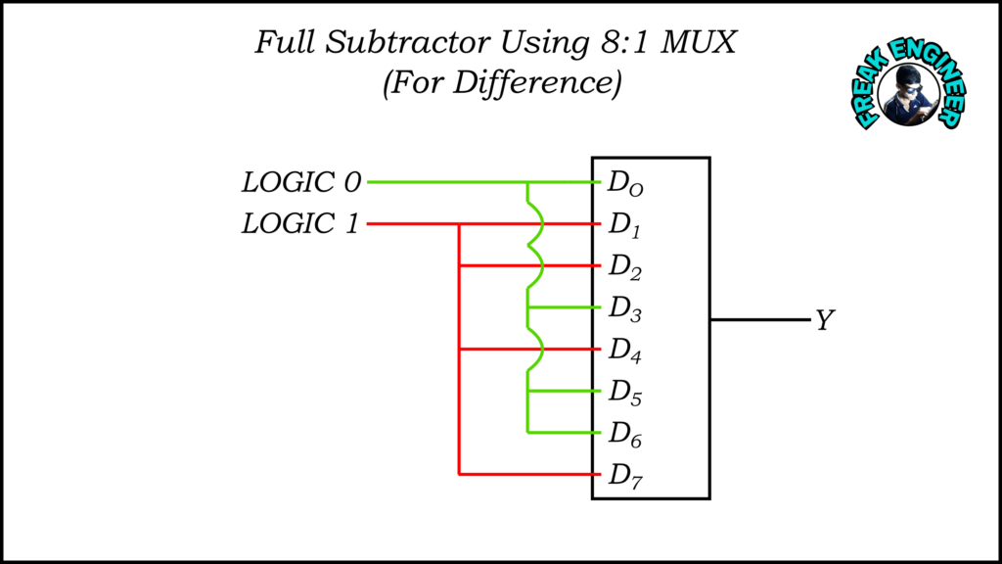
Lecture
SLIDE 13 / 14
Key Takeaways
1
Half subtractors handle single-bit subtraction without borrow-in
2
Full subtractors cascade to perform multi-bit binary subtraction
3
Borrow propagation is critical for correct subtraction results
4
Multiplexers select one input from many based on control lines
5
Multiplexers can implement any Boolean function efficiently
6
Both components are essential for arithmetic logic units
Source: freakengineer.com
Chandigarh University
13 / 14
Notes:
To summarize, half subtractors are for single bits, while full subtractors handle cascaded operations. Borrow propagation is key to accuracy. Multiplexers act as switches, selecting data based on control lines. They are powerful tools for implementing logic functions and reducing circuit complexity.

Slide 14
Lecture
SLIDE 14 / 14
References
COMPUTER ORGANIZATION AND DESIGN
The Hardware/Software Interface — David A. Patterson, John L. Hennessy
COMPUTER ARCHITECTURE
A Quantitative Approach — John L. Hennessy, David A. Patterson
• Computer Organization and Architecture — William Stallings
• Computer System Architecture — M. Morris Mano & Rajib Mall
• Computer Organization — Carl Hamacher, Zvonko Vranesic, Safwat Zaky
Chandigarh University
14 / 14
Notes:
These five textbooks provide comprehensive coverage of the topics discussed today. Stallings and Mano offer excellent foundational knowledge. Hamacher and the works by Patterson and Hennessy provide deeper insights into architecture and design. Please refer to these for further study and practice problems.

